Slide 1
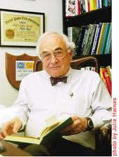



Slide 2
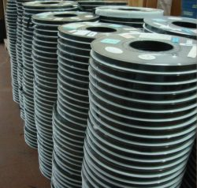
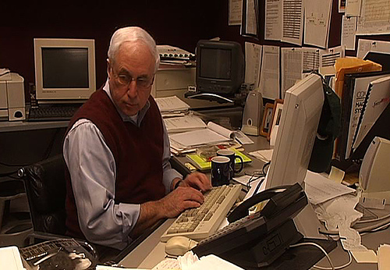

Slide 3


Slide 4
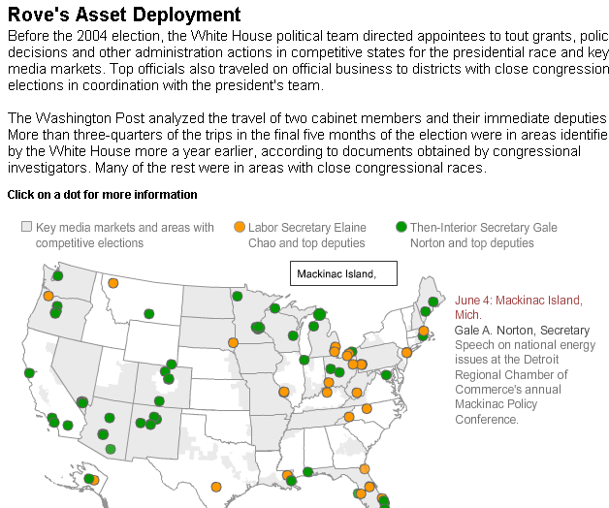

Slide 5
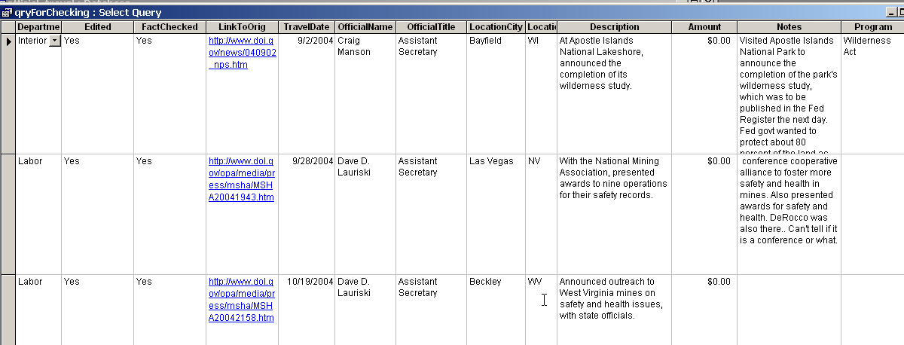

Slide 6
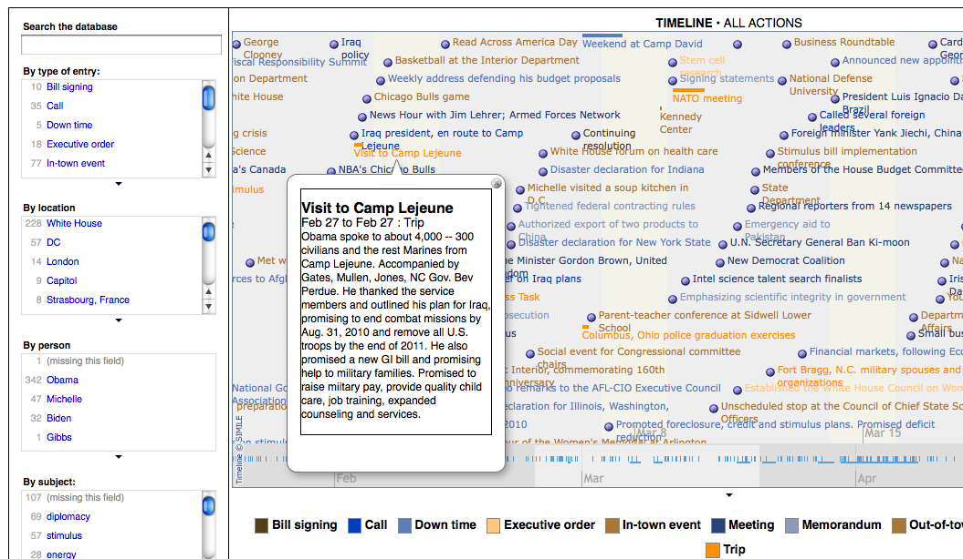
Resulting graphics at: http://www.washingtonpost.com/wp-srv/politics/obama/100days/
Notes:
Here’s another really bad attempt to visualize what Obama did in the first 100 days. The end result was something that we had to boil down into something like this:

Slide 7
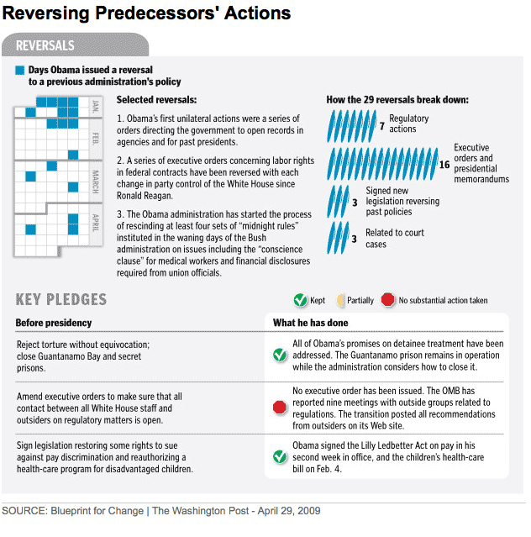
Sources: Original presidential documents, mainly in press release or pdf form
Notes:
There were several of these graphics, each of which involved examining that schedule. The process of building it helped, but the visualization didn’t.

Slide 8
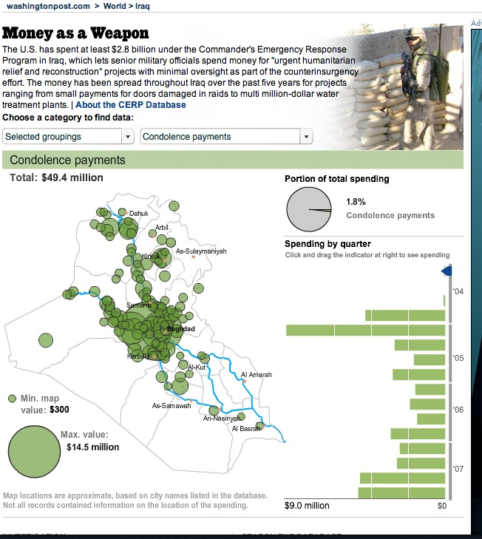
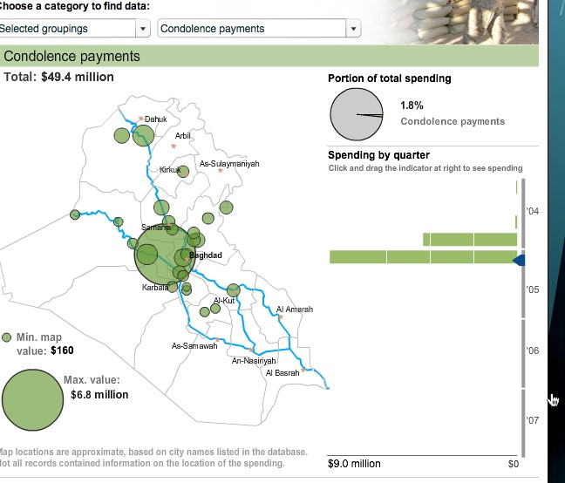
Washington Post: Money as a Weapon System – viz in reporting and transparency in publishing

Slide 9
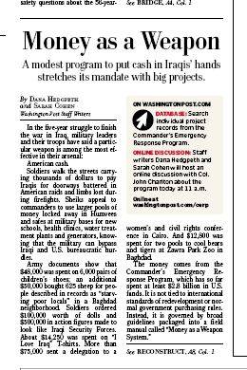
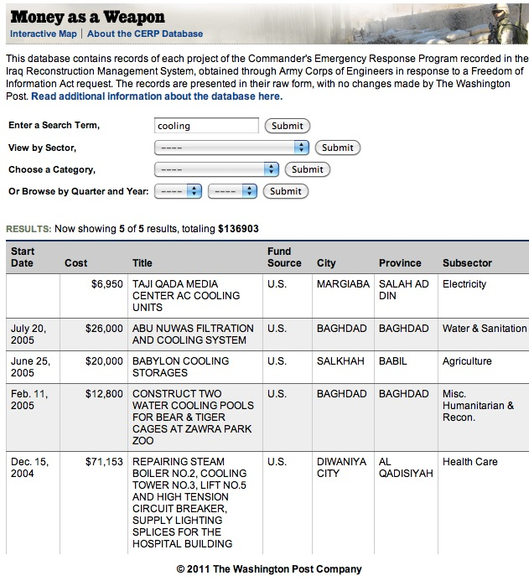
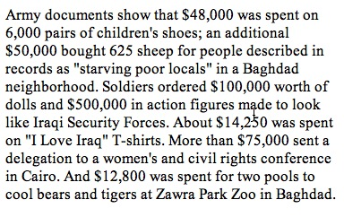

Slide 10

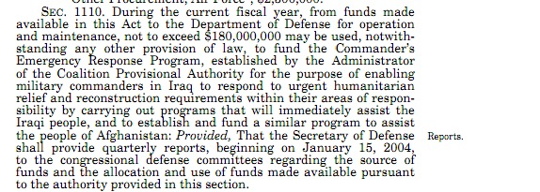
Notes:
Inspector general, GAO, audit reports

Slide 11
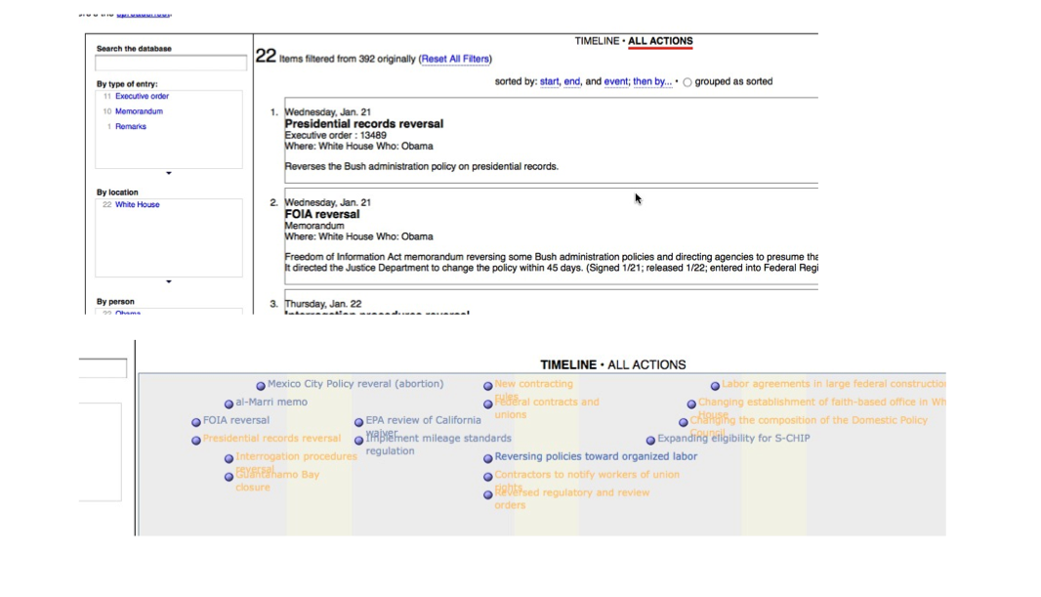

Slide 12
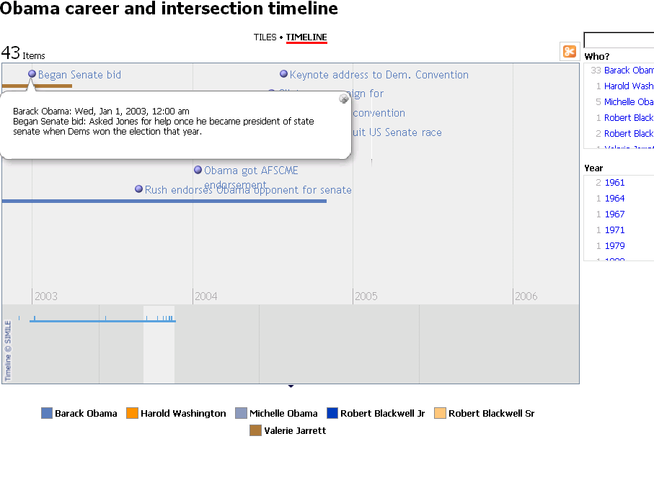

Slide 13

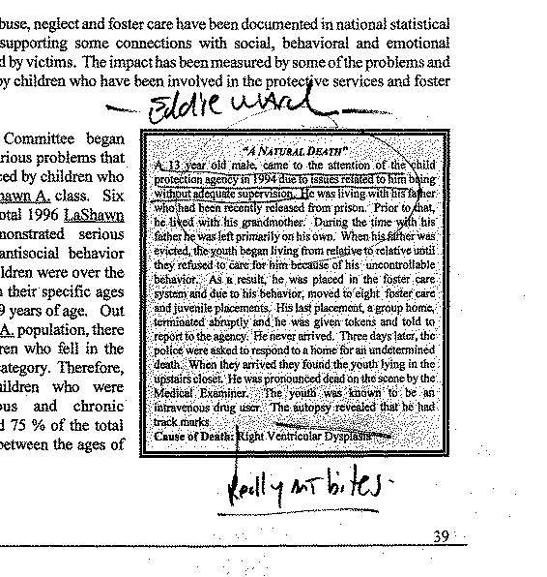

Slide 14
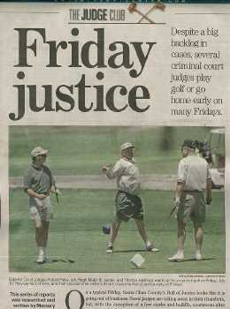

Slide 15
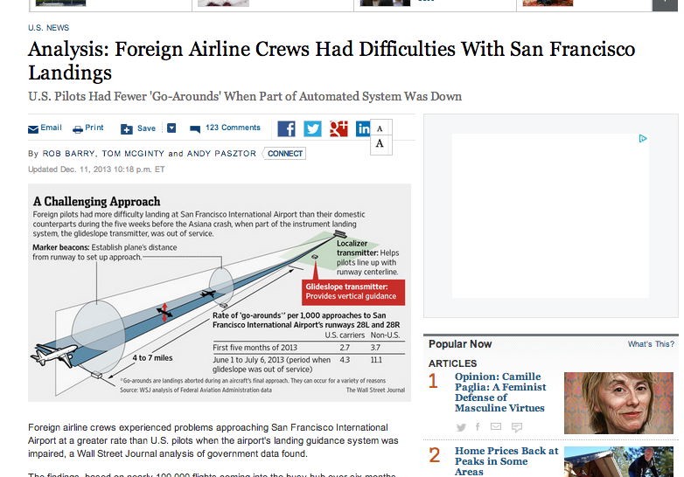

Slide 16
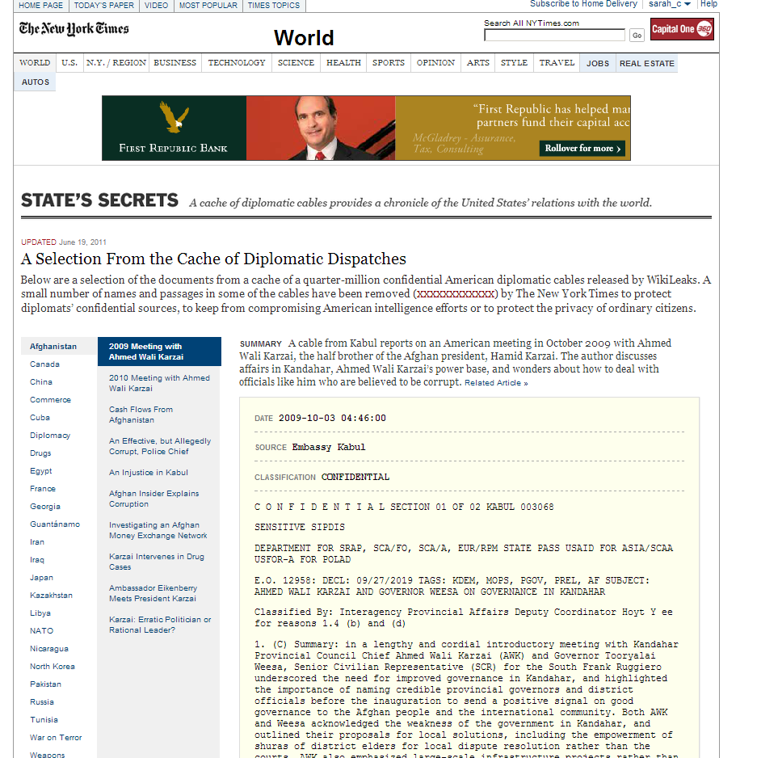
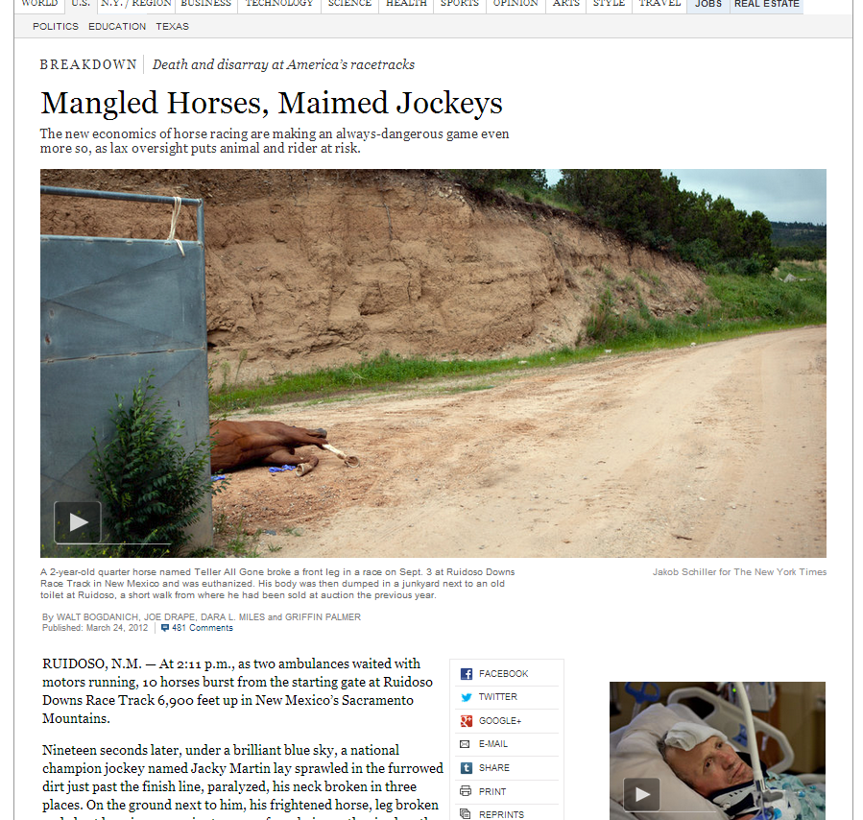
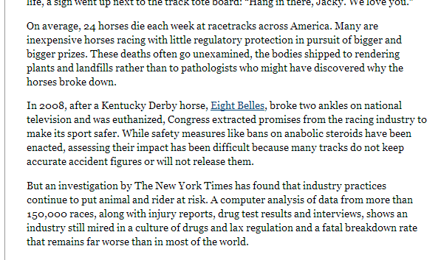

Slide 17
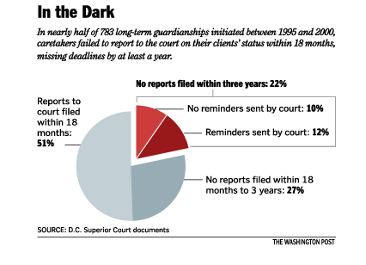

Slide 18
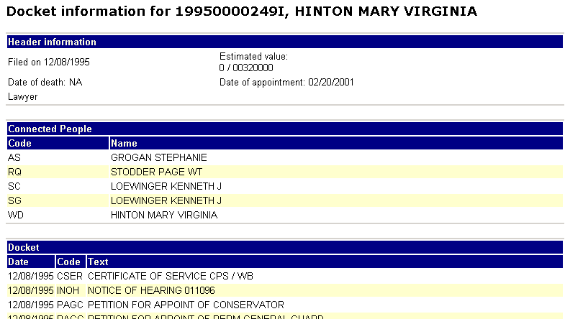
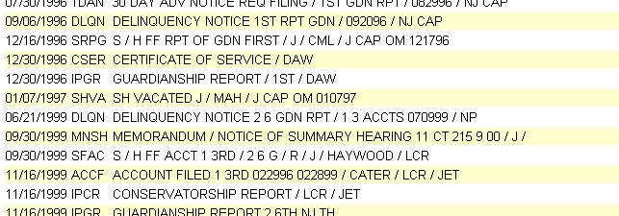

Slide 19
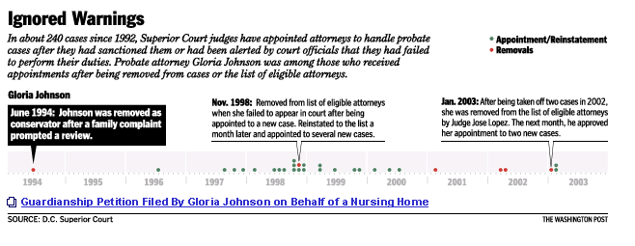
Notes:
One of the graphics showed one lawyer who kept getting appointments even though she was reprimanded.

Slide 20
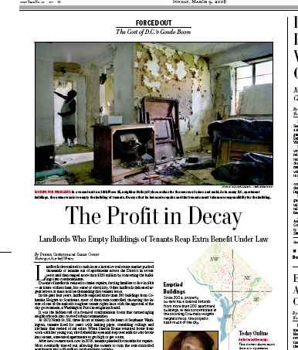

Slide 21
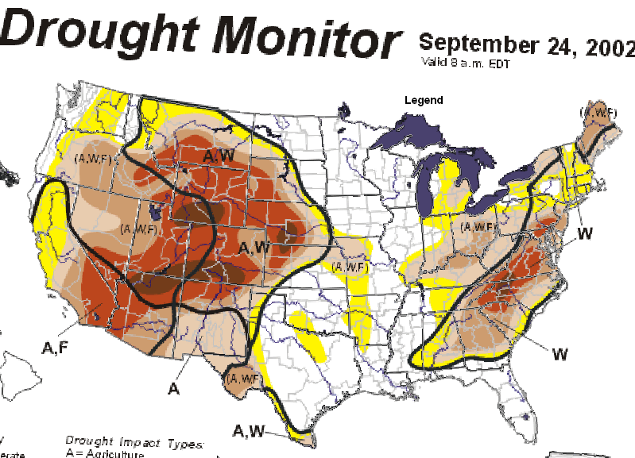
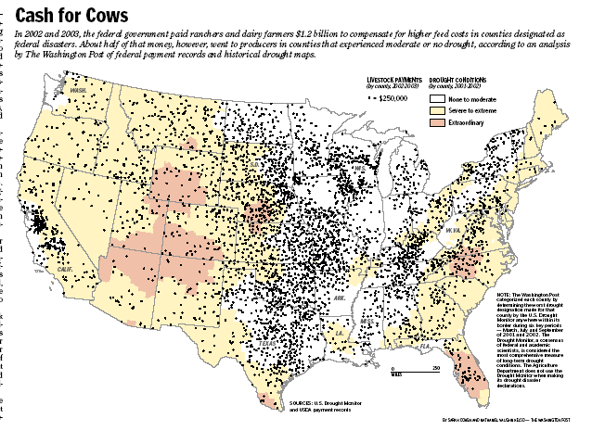
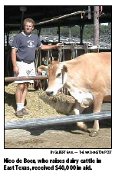
Notes:
Another story used a combinations of sources: subsidies paid to compensate ranchers and dairy farmers for drought; lists of disaster areas announced by FEMA and drought maps that were at the time only available as images for two years. I converted those drought maps to color codes, then found the deepest color in each county over two years to determine if the area every had a drought during the period. The final map shows that nearly half of the drought program went to property in counties that never suffered a drought – about $650 million. This is Nico De Boer, who was told by his local farm agency to come pick up his money. The reason he qualified: The tragic space shuttle flight that crashed went over his county, resulting in a disaster declaration. Another farm in Wisconsin got money for a snow storm in January, and another in Washington got money for an earthquake hundreds of miles away.

Slide 22

